Slide 1
Cryptocurrency and Alternate Systems
Reference Material
Deep Web
TOR

Slide 2
Surface, Deep, Dark Web

Slide 3
Surface {
Open for Browsing
Free access
Deep {
Log-In
Pay For Service
Dark {
Use of Different Servers
Different Technology
Ex. TOR

Slide 4
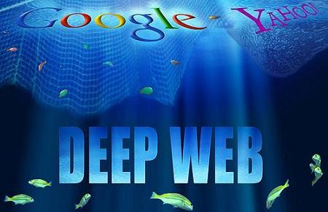
The “Darknet” “Deep Web,” “Invisible Web” Concept
Internet based networks which require additional authentication to use. These networks are designed to:
Refuse, reject indexing efforts
Requires additional software tools (Tor or Freenet) that are easy to obtain and use to gain access.
Notes:
Online locations where information is stored in a way that is typically not available to the public
Source: wikipedia and rela
(Here will be listed the Levels as they are represented in the most famous of the DeepWeb images. Other representations exist, however.)
Level 0 –
This level is the one you browse everyday: YouTube, Facebook, Wikipedia and other famous or easily accessible websites can be found here.
Level 1 – Surface Web
This level is still accessible through normal means, but contains “darker” websites, such as Reddit.
Level 2 – Bergie Web
This level is the last one normally accessible: all levels that follow this one have to be accessed with a proxy, Tor or by modifyig your hardware. In this level you can find some “underground” but still indexed websites, such as 4chan.
Level 3 – Deep Web
The first part of this level has to be accessed with a proxy. It contains CP, gore, hacking websites… Here begins the Deep Web. Second part of this level is only accessible through Tor, and contains more sensible information.
Level 4 – Charter Web
This level is also divided in two parts. The first can be accessed through Tor. Things such as drug and human trafficking, banned movies and books and black markets exist there. The second part can be accessed through a hardware modification: a “Closed Shell System”. Here, shit becomes serious. This part of the Charter Web contains hardcore CP, experimental hardware information (“Gadolinium Gallium Garnet Quantum Electronic Processors”…), but also darker information, such as the “Law of 13″, World War 2 experiments, and even the location of Atlantis.
Level 5 – Mariana's Web
Show Dark Web Video (up to 13:00 mins)

Slide 5
Level | Web Label | Description
0 | Common Web | Accessible through normal browsing activity; social media
1 | Surface Web | Accessible through normal means, contains hidden intranets, databases, web hosting
2 | Bergie Web | FTP servers, porn sites, honeypots and traps
3 | Deep Web (2 parts) | Requires access with proxy. Child porn, gore, hacking Requires use of Tor or other similar tool
4 | Charter Web (2 parts) | First part accessible with Tor. Drugs, CP, black markets Closed Shell System (hardware modification) – Hardcore, hunting endangered species, Silk Road
5 | Marianas Web | Arms trafficking, illegal, human drug testing, terrorism communication
6-8 | Dark Web | Government/Military
Notes:
Online locations where information is stored in a way that is typically not available to the public
(Here will be listed the Levels as they are represented in the most famous of the DeepWeb images. Other representations exist, however.)
Level 0 –
This level is the one you browse everyday: YouTube, Facebook, Wikipedia and other famous or easily accessible websites can be found here.
Level 1 – Surface Web
This level is still accessible through normal means, but contains “darker” websites, such as Reddit.
Level 2 – Bergie Web
This level is the last one normally accessible: all levels that follow this one have to be accessed with a proxy, Tor or by modifyig your hardware. In this level you can find some “underground” but still indexed websites, such as 4chan.
Level 3 – Deep Web
The first part of this level has to be accessed with a proxy. It contains CP, gore, hacking websites… Here begins the Deep Web. Second part of this level is only accessible through Tor, and contains more sensible information.
Level 4 – Charter Web
This level is also divided in two parts. The first can be accessed through Tor. Things such as drug and human trafficking, banned movies and books and black markets exist there. The second part can be accessed through a hardware modification: a “Closed Shell System”. Here, it becomes serious. This part of the Charter Web contains hardcore CP, experimental hardware information (“Gadolinium Gallium Garnet Quantum Electronic Processors”…), but also darker information, such as the “Law of 13″, World War 2 experiments.
Level 5 – Mariana's Web

Slide 6
Identify Deep/Dark Web Links http://deepweblinks.org

Slide 7
https://www.deepwebsiteslinks.com

Slide 8
TOR

Slide 9
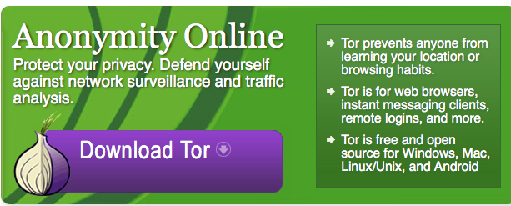
The Onion Router
Volunteer Based
Nodes in at least 84 Countries
5900+ Total Relay Nodes
Universities and Research Institutions most common
Invented by the Navy in 2002
Released to the public 2004
Protects against how we investigate suspicious activity
Encrypted Emails, documents, recordings, etc.
Complicates Tracerouting to point of impossible
Notes:
Ability for anonymity is significant. These directions were accessible on how to acquire Bitcoin with a degree of anonymity
Value Transfer – The Ripple Project
Suppose Alice and Bob know and trust each other on Ripple, as do Bob and Carol. If Alice wants to buy something for $10 from Carol using Ripple, the system will find a path through Bob. The transaction works like this: Bob agrees to owe $10 to Carol, and Alice agrees to owe $10 to Bob. The end result is that Alice owes a total of $10, Carol is owed a total of $10, and Bob is even overall.
To make use of this Ripple payment, Carol might want to then buy something for $8 from David. The system finds that David is connected to Alice, who is connected to Bob, who is connected to Carol. The transaction goes: Alice agrees to owe $8 to David, Bob agrees to reduce Alice's previous $10 debt to $2, and Carol agrees to reduce Bob's $10 debt to $2 as well. Now Alice still owes a total of $10, $8 to David and $2 to Bob; Bob is even overall, owing $2 to Carol and being owed $2 by Alice; Carol has a positive overall balance of $2; and David has a balance of $8.

Slide 10
https://torflow.uncharted.software
2021
2007
Notes:
Memex project, a “groundbreaking” search engine designed to best commercial titans like Google at searching the Deep Web and other oft-ignored terrain for the U.S. intelligence, law enforcement, and military. To build Memex, DARPA is partnered with universities like Carnegie Mellon, NASA, private research firms, and several Tor Project developers.
DARPA is funding multiple projects focused on improving Tor’s hidden services across “1-3 years,” Tor’s director of communications Kate Krauss told the Daily Dot via email. Tor declined to give more specifics on the grant, like its monetary value and terms, and DARPA didn’t respond to a request for comment.
Roger Dingledine, Tor’s project leader, pointed to a dozen projects over the last year that utilized DARPA’s funding including an investigation team assigned to address recent attacks on some of the Dark Net’s most famous websites.
These attacks, which started in March, targeted several hidden services with a simple-but-effective cyberattack that slowed the entire Tor network and took the sites offline for more than a week, inspiring no small amount of worry about the security of many Tor users. Some of the sites are still struggling to return to normalcy.
New technology developments, fixes and upgrades, and in-depth statistics on hidden services were among the work funded by DARPA’s grant under the Memex project.
The Dark Net road map moving forward is ambitious. Tor plans to double the encryption strength of hidden service’s identity key and to allow offline storage for that key, a major security upgrade.
Next-generation hidden services may be run from multiple hosts to better deal with denial of service attacks and high traffic in general, a potentially big power boost that further closes the gap between the Dark Net and normal websites.
Led by data scientist Christopher White, Memex is explicitly not aimed at de-anonymizing any Tor user or “accessing information not intended to be publicly available,” according to a recent DARPA blog post. Still, government funding of Tor—which, by the way, was invented as a U.S. Navy research project in 2002—has always been somewhat controversial.
This isn't the first time DARPA has contributed financially to Tor. A 2001-2006 stint as sponsor stands next to similar grants from the U.S. Navy, State Department, and the National Science Foundation as government sponsorships over the past decade.
Hidden services, which make up about 4 percent of the entire Tor network, have until recently been relatively neglected when it comes to funding and developing.
“The challenge with hidden services is two-fold,” Tor director Roger Dingledine told the Daily Dot. “First they're hard to frame as being within the mission of most funders in our space. Funders care about resisting censorship better, or training users about being safe online, or writing research papers on anonymous communications, but none of those are specifically about hidden services.”
Convincing the money is the hard part. Tor’s existence as a non-profit dependent on grants and donations means that development is, in a significant way, driven by what Tor can convince its sponsors are worthwhile causes.
“And second, hidden services are early enough in their development process that their potential is not as obvious as it is for other parts of Tor,” he explained. “They're basically still the same design and implementation I came up with 10 years ago, and while many other parts of Tor have become much stronger and smarter, attention to hidden services has lagged behind. The result is that it's harder to paint a picture about how any specific proposed project will bring them the required distance.”
In addition to DARPA, the hackers behind Tor are looking away from the big funders that have traditionally financed the operation. They’re turning to the crowd to fund development and bring hidden services into modernity, a long-awaited step that could have some major implications about how strong and secure Tor really is.
Illustration by Max Fleishman

Slide 11
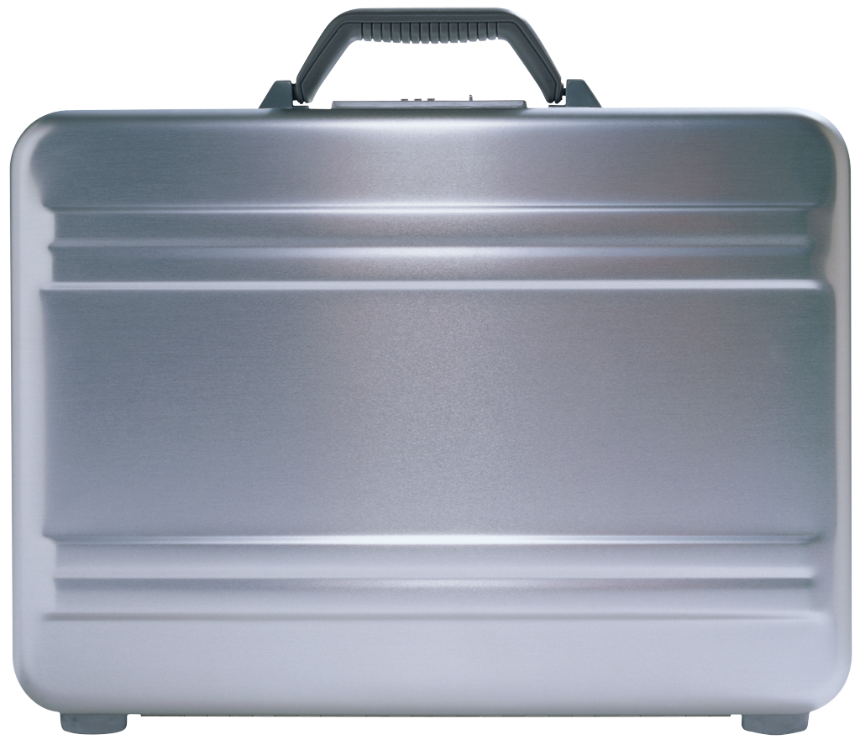
The TOR Relay Process
Entry/Guard Relay : Entry Point
Middle Relay: Routing Point. Secret Relays called bridges
Exit Relay: Routes traffic to the end site/service using a distributed table for the .onion sites
Entry/Guard Relay
Middle Relay
Exit Relay
Hidden
Service

